Slide 1
Social Distancing by BlackHats Santhosh Bharati & Ragul J C

Slide 2
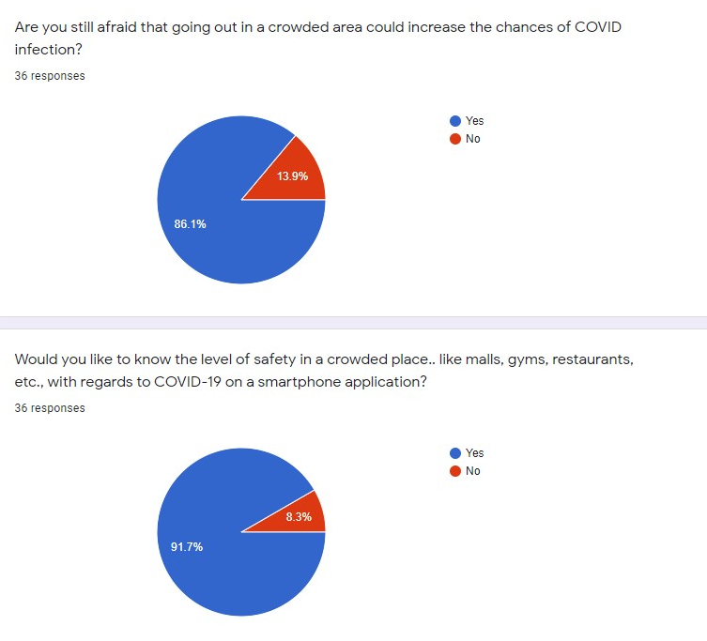
Problem Statement
Travelling during COVID situation
Places with high risks of crowd.
Economical way to estimate the size of a crowd.
Notify user in realtime

Slide 3
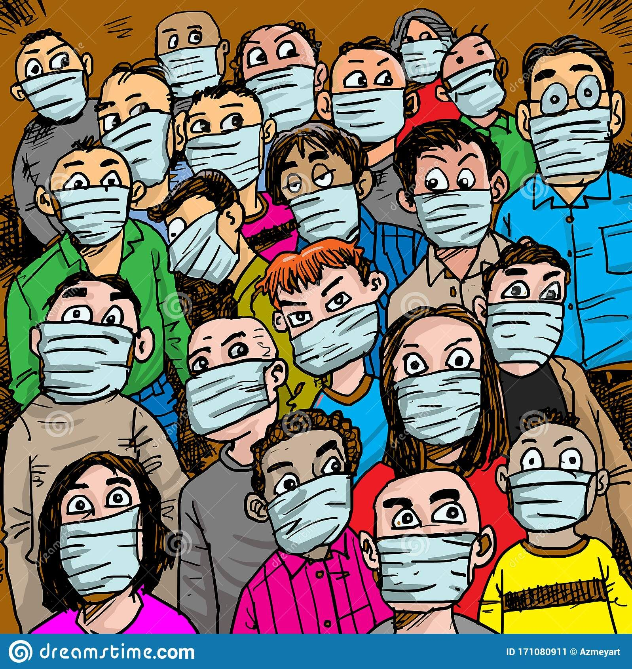
Propsal of solution
Estimate crowd size with CO2 meter
Notify users in real time regarding safety

Slide 4
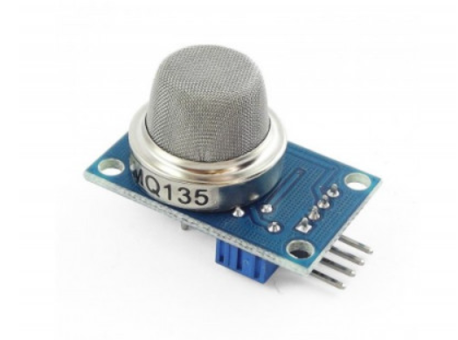
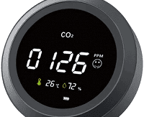
Apparatus for measuring CO2 levels
MQ135 type sensors to measure CO2 levels
Cost can be reduced by modifying the meter
Is installed at closed spaces/areas
The data collected is stored in a database

Slide 5
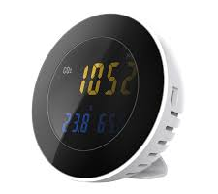
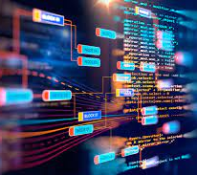
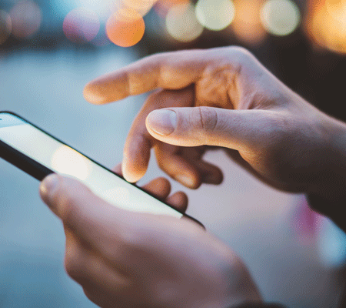
CO2 meter
data
database
app
user

Slide 6


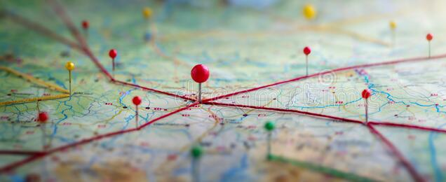
Notifying the user
Three levels – safe, possible crowd, too crowded
Google API is used for maps and other necessary features
An estimated range of people in the area is shown
The locations where our devices are installed is shown
User can also search for a location

